Slide 1


SCST1223
Probability & statistical data analysis
CHAPTER 5
Part 2
HYPOTHESIS TESTING
(One Samples Test)
Innovating Sustainable Solutions

Slide 2
Introduction
In statistics, a hypothesis is a claim or statement about a property of a population.
A hypothesis test (or test of significance) is a standard procedure for testing a claim about a property of a population.

Slide 3
Introduction
To conduct a Hypothesis Testing, we must establish the following :
Hypothesis statement
Test Statistic
Significance Level @ Level of confidence
Conclusion/Decision rule

Slide 4
STEP 1:
Hypothesis statement
STEP 2: Test Statistic
STEP 3: Significance Level @ Level of confidence
STEP 4: Conclusion/Decision rule

Slide 5
Examples - Hypotheses that can be tested
Genetics: The Genetics & IVF Institute claims that its XSORT method allows couples to increase the probability of having a baby girl.
Business: A newspaper headline makes the claim that most workers get their jobs through networking.
Medicine: Medical researchers claim that when people with colds are treated with Echinacea, the treatment has no effect.

Slide 6
Examples - Hypotheses that can be tested
Aircraft Safety: The Federal Aviation Administration claims that the mean weight of an airline passenger (including carry-on baggage) is greater than 185 lb, which it was 20 years ago.
Quality Control: When new equipment is used to manufacture aircraft altimeters, the new altimeters are better because the variation in the errors is reduced so that the readings are more consistent. (In many industries, the quality of goods and services can often be improved by reducing variation.)

Slide 7
1: Components of a Formal Hypothesis Test
Null Hypothesis: H₀
Alternative Hypothesis: H₁

Slide 8
Null Hypothesis: H₀
The null hypothesis (denoted by H₀) is a statement that the value of a population parameter (such as proportion, mean, or standard deviation) is equal to some claimed value.
We test the null hypothesis directly either reject H₀ or fail to reject H₀.
The symbolic form of the null hypothesis is: =

Slide 9
Alternative Hypothesis: H₁
The alternative hypothesis (denoted by H₁ or H_{a} or H_{A}) is the statement that the parameter has a value that somehow differs from the null hypothesis.
The symbolic form of the alternative hypothesis must use one of these symbols: ≠, <, >.

Slide 10
Types of Hypothesis Test: Two-tailed, Left-tailed, Right-tailed
Determinations of P-values and critical values are affected by whether a critical region is in two tails, the left tail, or the right tail. It therefore becomes important to correctly characterize a hypothesis test as two-tailed, left-tailed, or right-tailed.
The tails in a distribution are the extreme regions bounded by critical values.

Slide 11
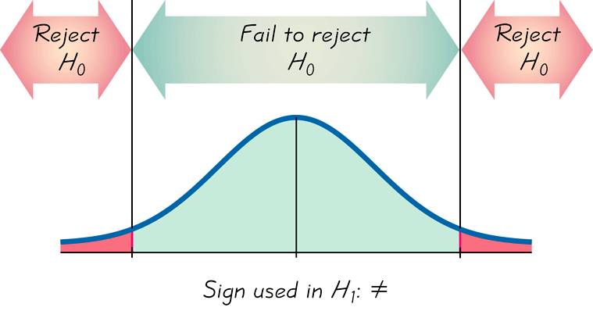
Two-tailed Test
H₀: =
H₁: ≠
α is divided equally between
the two tails of the critical
region
Means less than or greater than

Slide 12
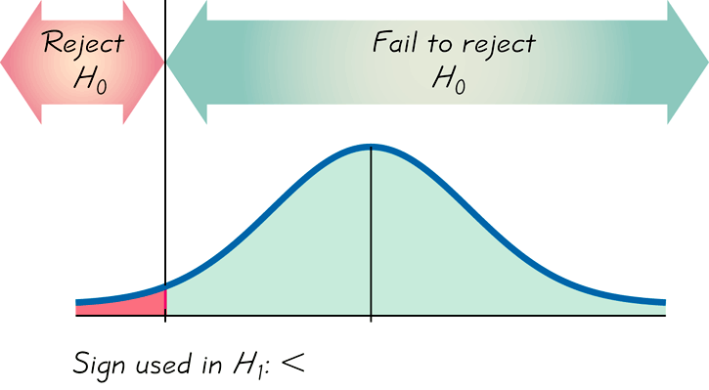
Left-tailed Test
H₀: =
H₁: <
α the left tail
Points Left

Slide 13
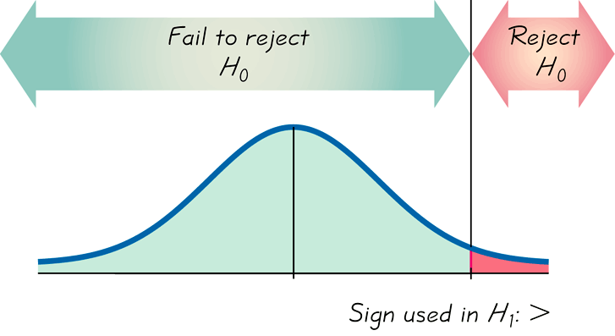
Right-tailed Test
H₀: =
H₁: >
α the right tail
Points Right

Slide 14
Example #1 - Stating Hypothesis
Sharing prescription drugs with others can be dangerous. A survey of a representative sample of 592 U.S. teens age 12 to 17 reported that 118 of those surveyed admitted to having shared a prescription drug with a friend. Is this sufficient evidence that more than 10% of teens have shared prescription medication with friends?
State the component of a hypotheses test:
H₀: p = 0.1
H₁: p > 0.1

Slide 15
Example #2 - Stating Hypothesis
Compact florescent (cfl) light bulbs are much more energy efficient than regular incandescent light bulbs. Eco bulb brand 60-watt cfl light bulbs state on the package “Average life 8000 hours”. People who purchase this brand would be unhappy if the bulbs lasted less than 8000 hours. A sample of these bulbs will be selected and tested.
State the component of a hypotheses test:
H₀: m = 8000
H₁: m < 8000
The true mean (m) life of the cfl light bulbs
One sided alternative.

Slide 16
Example #3 - Stating Hypothesis
Because in variation of the manufacturing process, tennis balls produced by a particular machine do not have the same diameters. Suppose the machine was initially calibrated to achieve the specification of m = 3 inches. However, the manager is now concerned that the diameters no longer conform to this specification. If the mean diameter is not 3 inches, production will have to be halted.
State the hypotheses:
H₀: m = 3
H₁: m ≠ 3
Two sided alternative

Slide 17
Exercise #1
For each pair of hypotheses, indicate which are not legitimate and explain why?

Slide 18
Exercise #2: Identify H₀ and H₁
The mean annual income of employees who took a statistics course is greater than $60,000.
The proportion of people aged 18 to 25 who currently use illicit drugs is equal to 0.20 (or 20%).
The standard deviation of duration times (in seconds) of the Old Faithful geyser is less than 40 sec.

Slide 19
STEP 1: Hypothesis statement
STEP 2: Test Statistic
STEP 3: Significance Level @ Level of confidence
STEP 4: Conclusion/Decision rule

Slide 20
2) Test of Statistical Hypothesis
A test statistic is computed using sample data and is the value used to reach a conclusion to reject or fail to reject H₀.
There are term/formula to calculate test statistic:
Test statistic for proportion:

Slide 21
Test statistic for population mean:
variance known or n > 30
variance unknown and n ≤ 30
Test statistic for population standard deviation:

Slide 22
Example
Let’s again consider the claim that the XSORT method of gender selection increases the likelihood of having a baby girl. Preliminary results from a test of the XSORT method of gender selection involved 14 couples who gave birth to 13 girls and 1 boy. The null and alternative hypotheses are H₀: p = 0.5 and H₁: p > 0.5. Calculate the value of the test statistic.

Slide 23
Example - Solution
Given: H₀: p = 0.5 and H₁: p > 0.5
The sample proportion of 13 girls in 14 births results in
Using p = 0.5, and n = 14, we find the value of the test statistic as follows:

Slide 24
STEP 1: Hypothesis statement
STEP 2: Test Statistic
STEP 3: Significance Level @ Level of confidence
STEP 4: Conclusion/Decision rule

Slide 25
3) Significance Level
The significance level (denoted by α) is the probability that the test statistic will fall in the critical region when the null hypothesis is actually true.
Common choices for α are 0.05, 0.01, and 0.10.

Slide 26
STEP 1: Hypothesis statement
STEP 2: Test Statistic
STEP 3: Significance Level @ Level of confidence
STEP 4: Conclusion/Decision rule

Slide 27
Decision Criterion
There are two types of decision criteria that can be used:
P-value method
Critical Region method

Slide 28
1. P-Value
The P-value (or p-value or probability value) is the probability of getting a value of the test statistic that is at least as extreme as the one representing the sample data, assuming that the null hypothesis is true.
A decision about whether to reject or fail to reject H₀ results from comparing the P-value to the chosen α:
H₀ should be rejected if P-value ≤ α ,
H₀ should not be rejected if P-value > α .

Slide 29
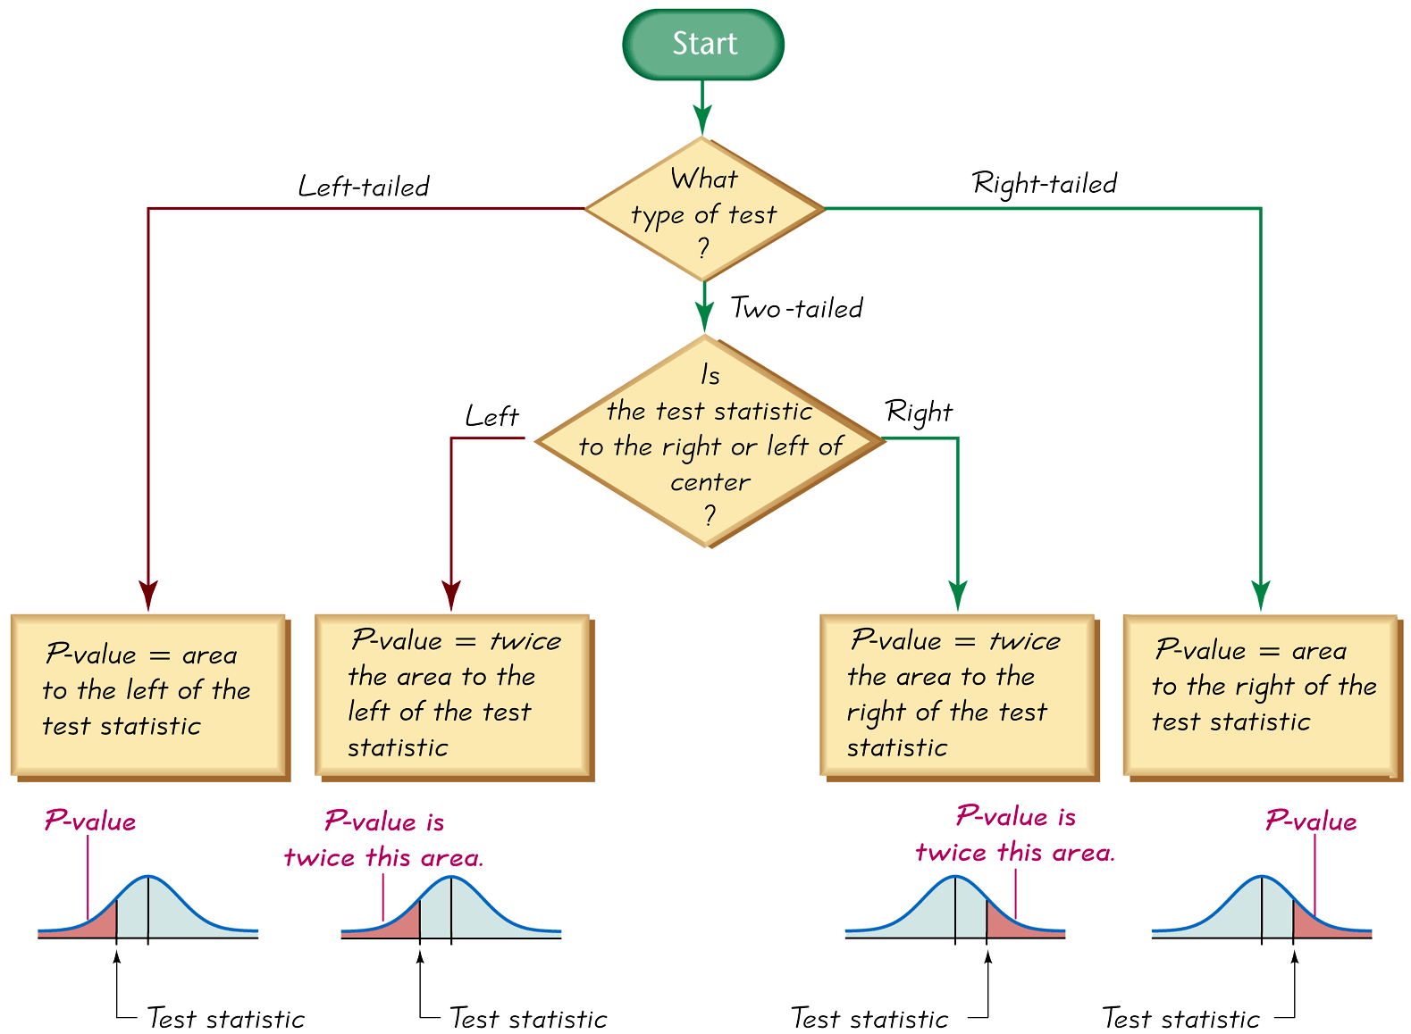
Procedure for Finding P-Value

Slide 30
2. Critical Region
The critical region (or rejection region) is the set of all values of the test statistic that cause us to reject the null hypothesis
A critical value is any value that separates the critical region (where we reject the null hypothesis) from the values of the test statistic that do not lead to rejection of the null hypothesis.

Slide 31
The critical values depend on the nature of the null hypothesis, the sampling distribution that applies, and the significance level α.
If the test statistic falls within the critical region, reject H₀.
If the test statistic does not fall within the critical region, fail to reject H₀.

Slide 32
Example: Find P-value
Finding P-value. Use a 0.05 significance level and state the conclusion about the null hypothesis (reject the null hypothesis or fail to reject the null hypothesis).
The test statistic in a left-tailed test is z = - 1.25.
The test statistic in a right-tailed test is z = 2.50.
The test statistic in a two-tailed test is z = 1.75

Slide 33
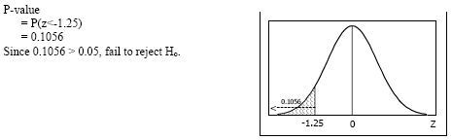
Example: Solution
The test statistic in a left-tailed test is z = - 1.25.
Answer:

Slide 34
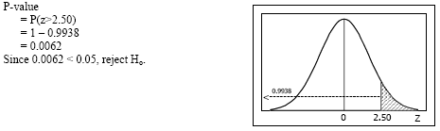
The test statistic in a right-tailed test is z = 2.50.
Answer:

Slide 35
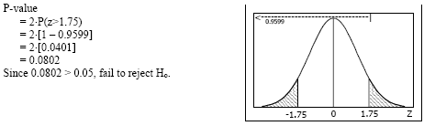
The test statistic in a two-tailed test is z = 1.75.
Answer:

Slide 36
Example
Consider the claim that with the XSORT method of gender selection, the likelihood of having a baby girl is different from p = 0.5, and use the test statistic z = 3.21 found from 13 girls in 14 births.
First determine whether the given conditions result in a critical region in the right tail, left tail, or two tails, then find the P-value.

Slide 37
Solution
The claim that the likelihood of having a baby girl is different from p = 0.5 can be expressed as p ≠ 0.5 so the critical region is in two-tails.
To find the P-value for a two-tails test, we see that the P-value is twice the area to the right of the test statistic z = 3.21.
So we have:
P(z > 3.21) = 1 – 0.9993 = 0.0007
.: P-value = 2 × 0.0007 = 0.0014 (two -tails)

Slide 38
Error of Decision

Slide 39
Error of Decision
A Type I error is the mistake of rejecting the null hypothesis when it is actually true.
The symbol α (alpha) is used to represent the probability of a type I error.
A Type II error is the mistake of failing to reject the null hypothesis when it is actually false.
The symbol β (beta) is used to represent the probability of a type II error.

Slide 40
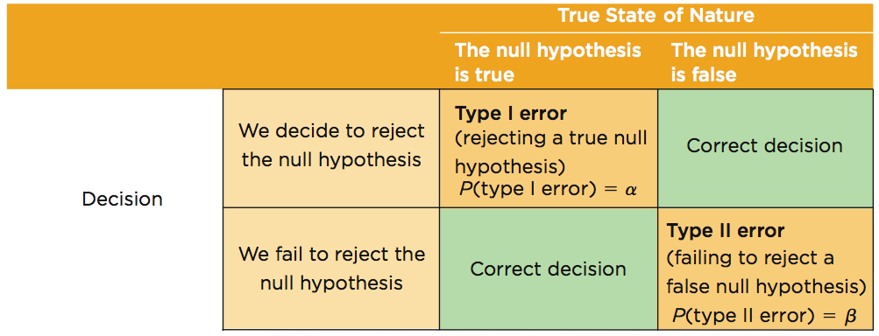
Type I and Type II Errors

Slide 41
Example
Assume that we are conducting a hypothesis test of the claim that a method of gender selection increases the likelihood of a baby girl, so that the probability of a baby girls is p > 0.5. Here are the null and alternative hypotheses: H₀: p = 0.5, and H₁: p > 0.5.
a) Identify a type I error.
b) Identify a type II error.

Slide 42
Solution
a) A type I error is the mistake of rejecting a true null hypothesis, so this is a type I error: Conclude that there is sufficient evidence to support p > 0.5, when in reality p = 0.5.
b) A type II error is the mistake of failing to reject the null hypothesis when it is false, so this is a type II error: Fail to reject p = 0.5 (and therefore fail to support p > 0.5) when in reality p > 0.5.

Slide 43
Hypothesis Testing Using a Single Sample

Slide 44
Review previous topic
To conduct a Hypothesis Testing, we must establish the following :
Hypothesis statement
Test Statistic
Significance Level @ Level of confidence
Conclusion/Decision rule

Slide 45
Type of Hypothesis Test – Single Sample
Test on mean, variance known.
Test on mean, variance unknown.
Test on variance/standard deviation.
X

Slide 46
Steps in Hypothesis Testing
1. From the problem context, identify the parameter of interest.
2. State the null hypothesis, H₀.
3. Specify an appropriate alternative hypothesis, H₁ .
4. Choose a significance level α.
5. Determine an appropriate test statistic.
6. State the rejection region for the statistic.
7. Compute any necessary sample quantities, substitute these into the equation for the test statistic, and compute that value.
8. Decide whether or not H₀ should be rejected and report that in the problem context.
Steps 1 – 4 should be completed prior to examination of the sample data.

Slide 47
Type of Hypothesis Test – Single Sample
Test on mean, variance known.
Test on mean, variance unknown.
Test on variance/standard deviation.
X

Slide 48
Test on Mean, Variance Known
When either n is large or the population distribution is approximately normal, then
with variance, σ is known.

Slide 49
The distribution of Z₀ when H₀: µ= µ₀ is true, with critical region (a) the two-sided alternative H₁: µ ≠ µ₀ (b) the one-sided alternative H₁: µ>µ₀ and (c) the one-sided alternative H₁: µ<µ₀.

Slide 50
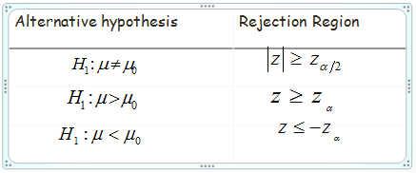
Null hypothesis : H₀: μ =μ_{ο}
Test statistic:
Notes:
Alternative hypothesis
Rejection Region

Slide 51
Example
Writing a Hit Song: In the manual “How to Have a Number One the Easy Way,” by KLF Publications, it is stated that a song “must be no longer than three minutes and thirty seconds” (or 210 seconds). A simple random sample of 40 current hit songs results in a mean length of 252.5 sec. Assume that the standard deviation of song lengths is 54.5 sec. Use a 0.05 significance level to test the claim that the sample is from a population of songs with a mean greater than 210 sec. What do these results suggest about the advice given in the manual?

Slide 52
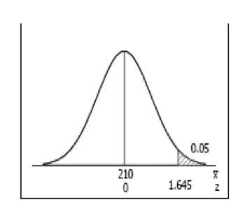
Solution
Conclusion: Reject H₀ ; there is sufficient evidence to conclude that μ > 210 sec. These results suggest that the advice given in the manual is not good advice.

Slide 53
Exercise #3
Red Blood Cell Count: A simple random sample of 50 adults is obtained, and each person’s red blood cell count (in cells per microliter) is measured. The sample mean is 5.23. The population standard deviation for red blood cell counts is 0.54. Use a 0.01 significance level to test the claim that the sample is from a population with a mean less than 5.4, which is a value often used for the upper limit of the range of normal values. What do the results suggest about the sample group?

Slide 54
Type of Hypothesis Test – Single Sample
Test on mean, variance known.
Test on mean, variance unknown.
Test on variance/standard deviation.
X

Slide 55
Test on Mean, Variance Unknown
Test statistic concerning one mean for data that can be assumed to follow a normal distribution but variance is unknown and the sample is small (n ≤ 30), the test statistic is:
When testing hypothesis concerning one mean for data that can be assumed to follow a normal distribution and variance is unknown, but the sample is large (n > 30), the test statistic is:

Slide 56
The reference distribution for H₀: µ= µ₀ with critical region for (a) the two-sided alternative H₁: µ≠ µ₀ (b) the one-sided alternative H₁: µ>µ₀ and (c) the one-sided alternative H₁: µ<µ₀.

Slide 57
Example
The increased availability of light materials with high strength has revolutionized the design and manufacture of golf clubs, particularly drivers. Clubs with hollow heads and very thin faces can result in much longer tee shots, especially for players of modest skills. This is due partly to the “spring-like effect” that the thin face imparts to the ball. Firing a golf ball at the head of the club and measuring the ratio of the outgoing velocity of the ball to the incoming velocity can quantify this spring-like effect. The ratio of velocities is called the coefficient of restitution of the club. An experiment was performed in which 15 drivers produced by a particular club maker were selected at random and their coefficients of restitution measured. In the experiment the golf balls were fired from an air cannon so that the incoming velocity and spin rate of the ball could be precisely controlled. It is of interest to determine if there is evidence (with α= 0.05) to support a claim that the mean coefficient of restitution exceeds 0.82. The observations follow:
0.8411 0.8191 0.8182 0.8125 0.8750 0.8580 0.8532 0.8483 0.8276 0.7983 0.8042 0.8730 0.8282 0.8359 0.8660

Slide 58
Example: Solution
Hypothesis:
H₀: µ = 0.82
H₁: µ > 0.82.
α = 0.05.
The test statistic is:
c.v: t_{0.05,14} = 1.761.
Conclusion: Reject H₀; there is sufficient evidence that the mean coefficient of restitution exceeds 0.82.

Slide 59
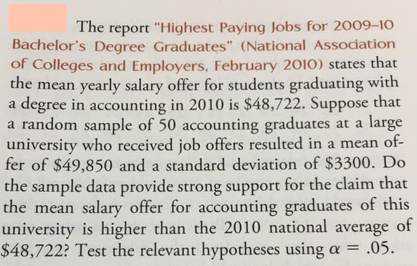
Exercise #4

Slide 60
Type of Hypothesis Test – Single Sample
Test on mean, variance known.
Test on mean, variance unknown.
Test on variance/standard deviation.
X

Slide 61
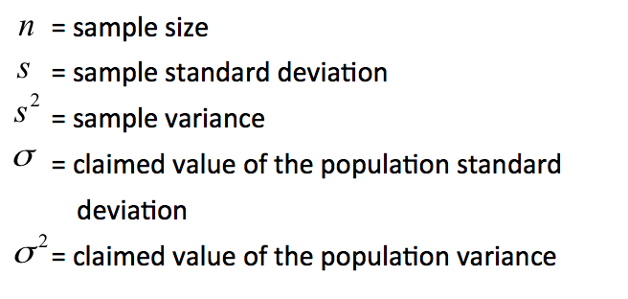
Test on Variance / Standard Deviation
Test statistic: Chi-Square Distribution

Slide 62
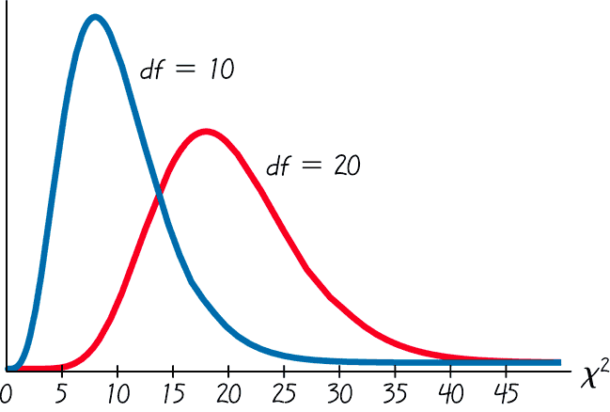
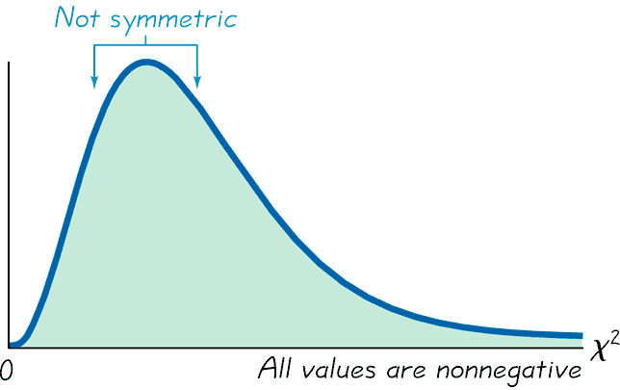
Properties of Chi-Square Distribution
Properties of the Chi-Square Distribution
Chi-Square Distribution for 10 and 20 df
Different distribution for each number of df.

Slide 63
The reference distribution for H₀: σ² = σ₀² with critical region for (a) the two-sided alternative H₁: µ≠ µ₀ (b) the one-sided alternative H₁: µ>µ₀ and (c) the one-sided alternative H₁: µ<µ₀.

Slide 64
Example
A police chief claims that the standard deviation in the length of response times is less than 3.7 minutes. A random sample of nine response times has a standard deviation of 3.0 minutes.
At α = 0.05, is there are enough evidence to support the police chief’s claimed? Assume the population is normally distributed.

Slide 65
Example: Solution
Hypothesis statement:
Test statistic:

Slide 66
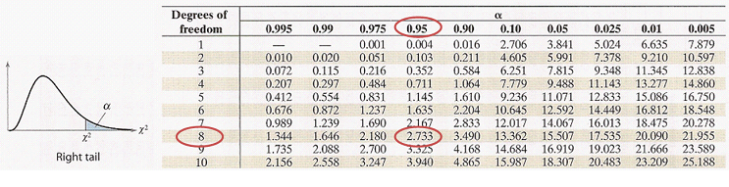
Why are we using right tail?
This is the way the chi-square table is designed. So if its left-tail 5%, use the number for right-tail 95% (i.e., 1-α). Thus,
Conclusion: Since 2.733 < 5.259, fail to reject H₀. There is sufficient evidence that support the standard deviation in the length of response times is 3.7 minutes.

Slide 67
Exercise #5
A dairy processing company claims that the variance of the amount of fat in the whole milk processed by the company is no more than 0.25. You suspect this is wrong and find that a random sample of 41 milk containers has a variance of 0.27. At α = 0.05, is there are enough evidence to reject the company’s claimed? Assume the population is normally distributed.

